Slide 1
Wizeline DEB Bootcamp
Capstone Project Presentation

Slide 2




Sidney Ochoki Isoe
Roles: Software Implementation Consultant | Business Analyst | Data Enthusiast
Experience: Working with data for over a decade
Hobbies: Music, video games, data
Contact:
use sidneyisoe

Slide 3
Session Goal The goal is to explain my end-to-end solution used for the capstone project.
Introduction
Infrastructure
Data Pipelines
Challenges
Lessons Learned

Slide 4




1. Introduction
The objective of the project was to use the GCP technologies and data engineering techniques to build an end-to-end solution for movie analytics data warehouse.

Slide 5
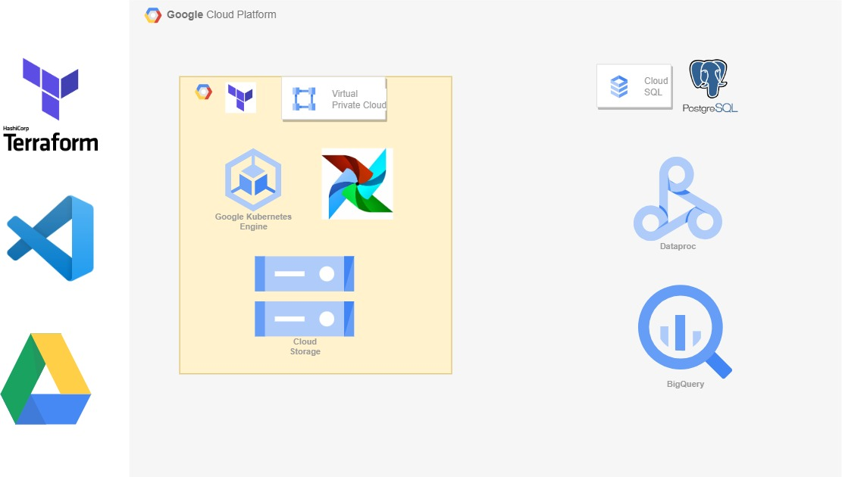
2. Infrastructure

Slide 6
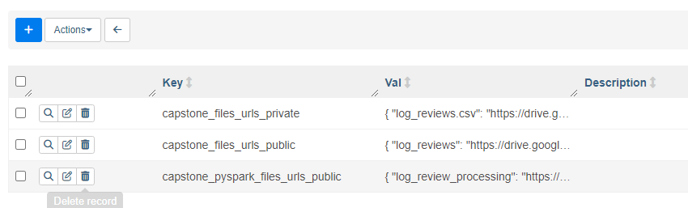
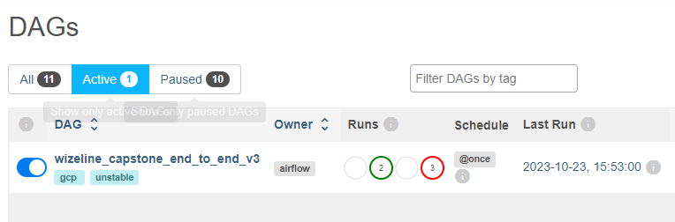
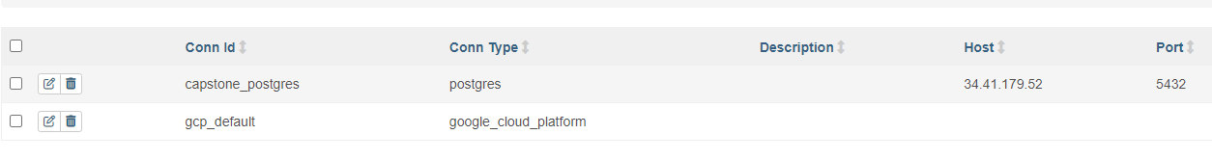
Airflow Pipeline
Variables
One end-to-end solution
Connections

Slide 7




Pipeline – load data to RAW
Data Ingestion
movie_review.csv
log_reviews.csv
user_purchase.csv
user_purchase.csv file into a PostgreSQL DB
movie_review.csv and log_reviews.csv into a storage bucket

Slide 8
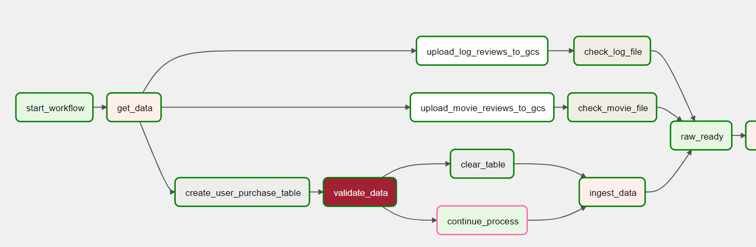

Pipeline – load data to RAW
Apache Airflow: Phase 1
user_purchase.csv file into a PostgreSQL DB
movie_review.csv and log_reviews.csv into a storage bucket

Slide 9
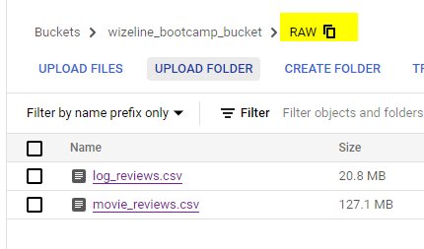
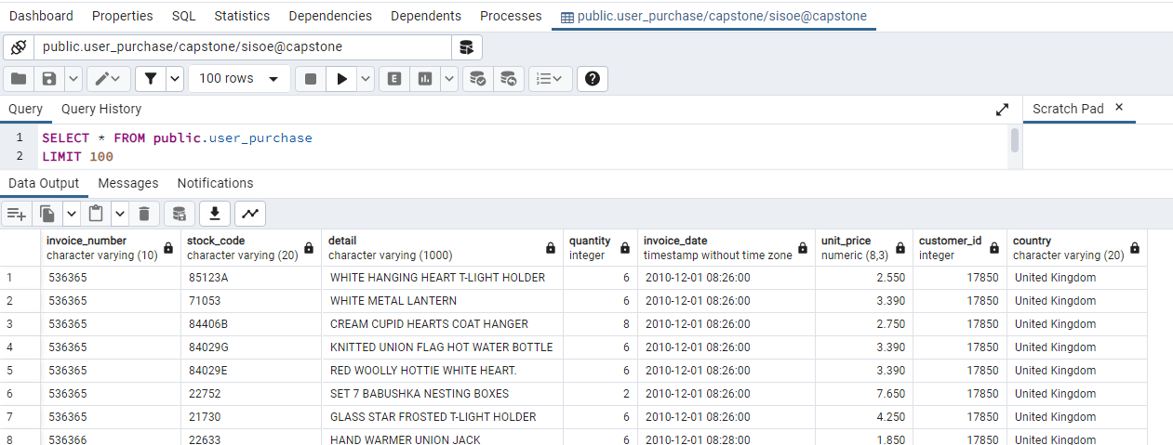
Pipelines – ingested data

Slide 10



Pipelines – RAW to STAGING
Transformation
Stage
Raw
movie_review.csv
log_reviews.csv
classified_movie_review.csv
review_logs.csv
user_purchase.csv
user_purchase.csv
log_review_processing.py
movie_review_positive_sentiment.py

Slide 11
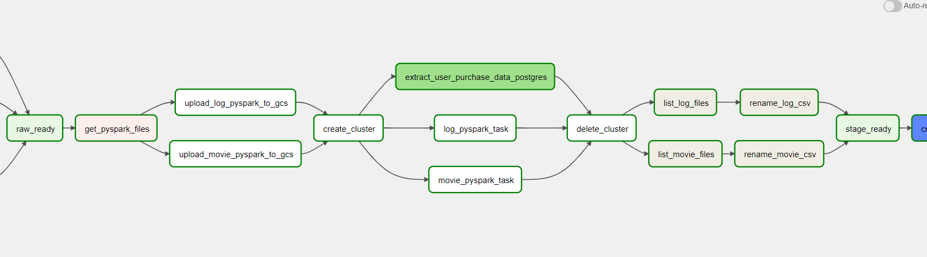
Pipelines – RAW to STAGING
Apache Airflow: Phase 2
Transforming the data by submitting a PySpark job into Dataproc
The PySpark code is imported from Google Drive
Extracting the user_purchase data from PostGres
Combining the part files from Spark into single csv files using a python operator

Slide 12
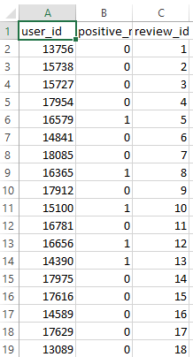
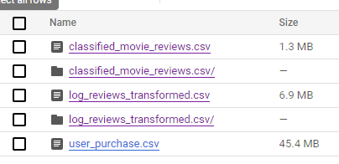
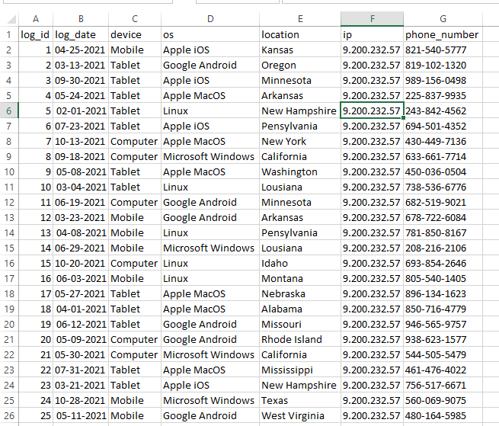
Pipelines – RAW to STAGE
classified_movie_review.csv
STAGE bucket
review_logs.csv

Slide 13
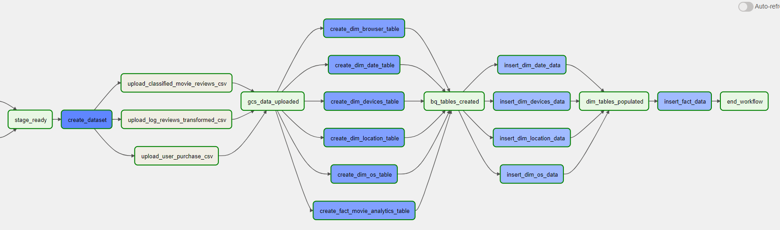

Pipelines – STAGING to Data Warehouse
Apache Airflow: Phase 3
Uploaded data from GCS to BigQuery
Created a Data Warehouse star schema (dimension and fact tables) in Google BigQuery.
Inserted data from tables linked to staging data into dimension and fact tables

Slide 14
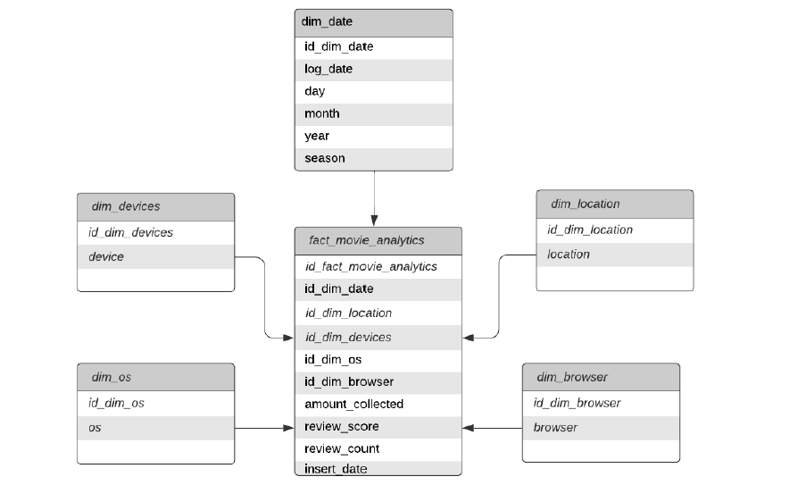
Pipelines –Data Warehouse Schema
Inserted data from the STAGING data into an appropriate star schema

Slide 15
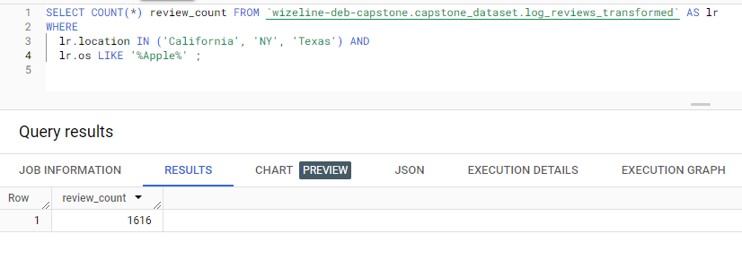
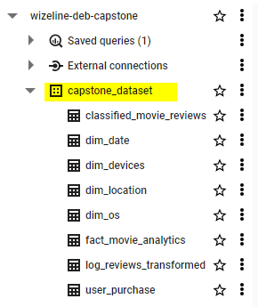
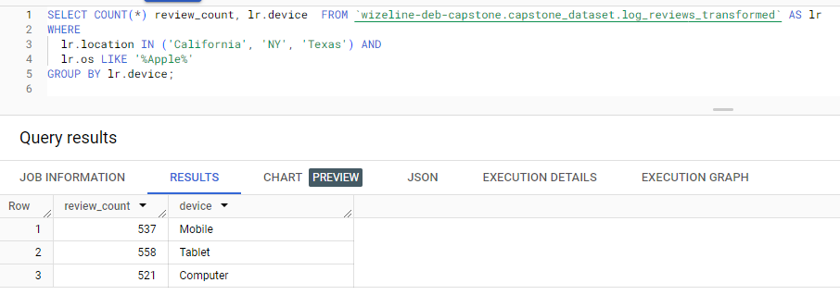
BigQuery (DW) - Analytics

Slide 16
Lessons Learned
Airflow
IaC / Terraform
Cloud vs On-premise
Data storage options
Big Data processing

